Slide 1
Lecture 1: Introduction to Cyber Security
Objective:
Describe the formal definition of Computer Security
Describe Confidentiality, Integrity, and Availability as the key security requirements
Computer Security Model and Strategy
Describe the security threats and attacks types
Recommended Texts
W. Stallings and L. Brown, “Computer Security, Principles and Practice, 2nd edition, Pearson, 2012, Chapter 1.
Supplementary text
Charles P. Pfleeger and Shari L. Pfleeger, Security in Computing (3rd edition). Prentice-Hall. 2003. ISBN: 0-13-035548-8.

Slide 2
Computer Security
Definition (NIST Computer Security Handbook)
The protection afforded to an automated information system in order to attain the applicable objectives of preserving the integrity, availability, and confidentiality of information system resources (includes hardware, software, firmware, information/data, and telecommunications).
Key objectives of Computer Security:
Confidentiality
Integrity
Availability

Slide 3
Computer Security Objectives
1) Confidentiality (C).
This term covers two related concepts.
  Data confidentiality. Assures that confidential information is not made available or disclosed to unauthorized individuals.
  Privacy. Assures that the owners have control on:
    What information related to them may be collected and stored,
    By whom and to whom that information may be disclosed.
  NIST’s Requirement: Preserve authorized restrictions on information access and disclosure, including means for protecting personal privacy and proprietary information
  Loss of confidentiality means unauthorized disclosure of information.

Slide 4
Objectives (cont.)
2) Integrity (I).
This term covers two related concepts.
  Data integrity: Information and programs are changed only in a specified and authorized manner.
  System integrity: A system performs its intended function
    in an unimpaired manner, and
    free from deliberate or inadvertent unauthorized manipulation of the system.
Requirement: Guard against improper information modification or destruction, including ensuring information nonrepudiation authenticity.
Loss of Integrity means unauthorized modification or destruction of information.

Slide 5
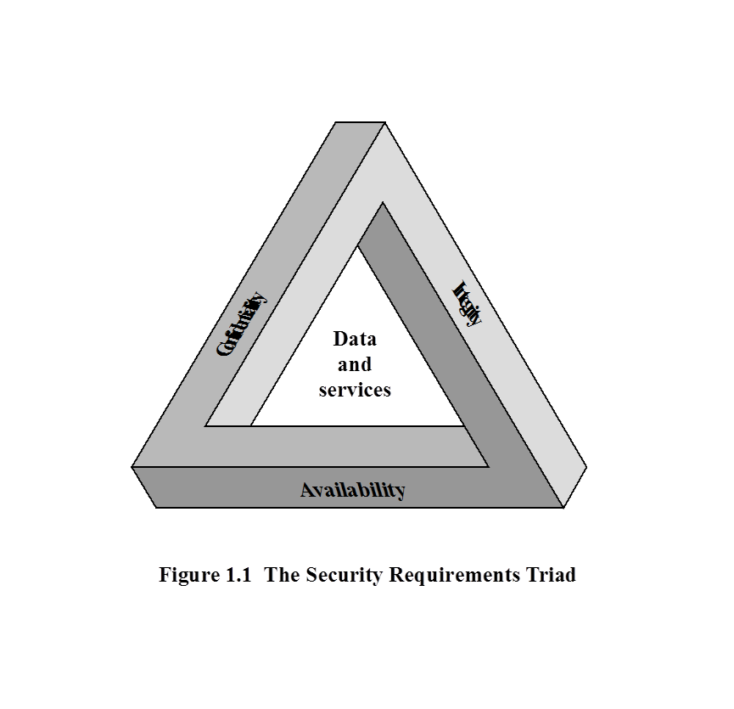
Objectives (cont.)
3) Availability (A).
Systems work promptly and service is not denied to authorized users.
NIST’s requirement: Ensuring timely and reliable access and use of information.
Loss of Availability means disruption to the authorized users in accessing or use of information.
Figure from Stallings & Brown textbook

Slide 6
Additional Objectives
Authenticity: Able to verify that
  the users are who they claim they are, and
  the system receives data from a trusted source.
NIST includes authenticity as part of Integrity
5) Accountability: Able to trace back the actions performed by an entity to that entity.
Accountability supports: nonrepudiation, deterrence, fault isolation, intrusion detection and prevention, after-action recovery and legal action.
Read the examples of C-I-A in the textbook (Stallings & Brown)

Slide 7
Computer Security Model (RFC 2828)
System Resource or asset that needs to be protected
Hardware: e.g., Computer System, data storage, communication devices.
Software: e.g., operating systems, program utilities and applications.
Data: e.g., data and password files, databases.
Communication facilities and networks: e.g., LAN, WAN, routers, etc.
Vulnerabilities of system resources
Definition: A flaw or weaknesses in a system’s design, implementation, or operation and management that could be exploited to violate the system’s security policy.
When the resource is corrupted → violate Integrity
When the resource is leaky → violate Confidentiality
When the resource is unavailable → violate Availability

Slide 8
Computer Security Model
3) Threat is a possible danger that might exploit a vulnerability.
It represents a potential harm to the system resource.
4) Attack is a threat that is carried out (threat action)
Two attack types:
Active attack: An act that has negative effects on system resources
Passive attack: An act to make use of system information but it does not affect the system
The origin of an attack:
Inside attack is carried out by an entity inside the security perimeter.
Outside attack is performed by an unauthorized users.

Slide 9
Computer Security Model (cont.)
5) Adversary is an entity that carried out an attack
  A threat agent or an attacker.
6) Countermeasure is any means taken
  to address an attack,
  to prevent an attack from being successful,
  to detect the attack if the attack is successful, and
  to recover from the damage due to the attack.
7) Risk is the expected loss due to a particular attack.
  Examples?

Slide 10
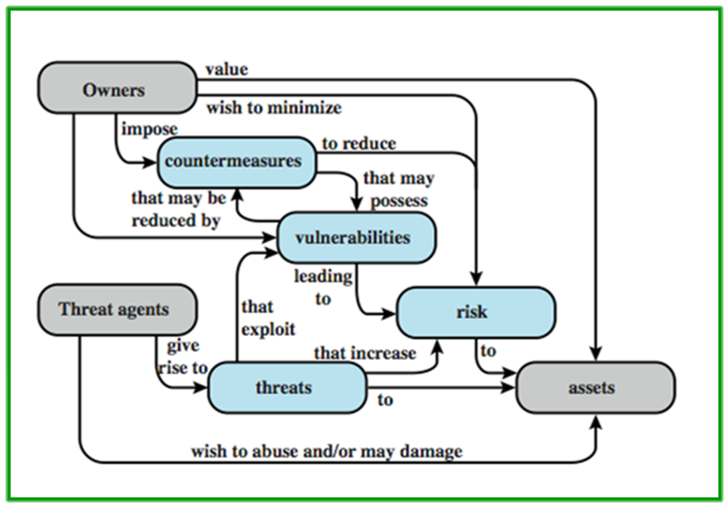
Computer Security Model
Figure from Stallings & Brown textbook

Slide 11
Threats and Attacks
Four kinds of threats and their types of attacks (RFC 2828)
1) Unauthorized disclosure: a threat to system confidentiality
Types of Attacks:
Exposure. The attacker obtains unauthorized knowledge of sensitive data.
Interception. The attacker gain access to data being transmitted
  A common attack in communication network
Inference. The attacker gains information from analyzing the pattern of traffic in a network
Intrusion. The attacker gains unauthorized access to data
  Probably after breaking the system’s access control protection

Slide 12
Threats and Attacks (cont.)
2) Deception: a threat to system or data integrity
Types of Attacks:
Masquerade. The attacker accesses to the system acting as an authorized user
  the attacker may have the login name and password.
Falsification. The attacker modifies or replaces valid data or produces false data
Repudiation. The attacker denies
  sending the data,
  denies receiving the data, or
  Possessing the data

Slide 13
Threats and Attacks
3) Disruption: a threat to system availability and integrity
Types of Attacks:
Incapacitation. An attack on system availability by destructing or damaging system resources (e.g., hardware) and their services.
Corruption. An attack to system integrity such that the system resources or services operate in an unintended manner.
  This can be done by a malware or an attacker that modifies system function
Obstruction. An attack to system availability by interfering, altering, or overloading communication functions

Slide 14
Threats and Attacks
4) Usurpation: a threat to system integrity
Types of Attacks:
Misappropriation. An unauthorized software uses the OS and hardware resources
  E.g., DoS attack that steals system services
Misuse. Disabling security functions, can be by the following means:
  malicious logic, or
  an attacker that gains access to the system

Slide 15
Threats and Assets
Four categories of assets and their attacks.
1) Threats on hardware: attack on system availability
e.g., damaging or stealing the hardware
2) Threats on software: attack of system availability and integrity/authenticity
e.g., deleting and damaging (availability), and modifying (integrity/authenticity) the software
3) Threats on data: attack on availability, integrity and confidentiality
e.g., destroying data (availability), accessing and analyzing unauthorized data a(confidentiality), and modifying data (integrity)

Slide 16
Threats and Assets
4) Threats on communication lines and networks: can be passive or active attacks
Passive attack is performed by eavesdropping or monitoring data transmission
The attacker only learns or makes use of information without affecting system resources
Passive attack is hard to detect because data is not altered
  Use attack prevention (not detection) to handle it
Two types of passive attacks.
Release of message contents (confidentiality)
Traffic analysis, if the data is encrypted.

Slide 17
Threats and Assets (cont. )
4) Threats on communication lines and networks (cont. )
Active attacks alters system resources or affecting their operations
Active attack is difficult to prevent but easy to detect
Four categories of active attack:
Replay. Capture and retransmit data unit to produce an unauthorized effect
Masquerade. One entity pretends to be another entity
  It usually includes other form of attack, e.g., replay
Data modification. Alter some portion of legitimate data, delay the data, or reorder the data to produce an unauthorized effect
Denial of Service. Prevent or disallow the legitimate use of facilities

Slide 18
Security Functional Requirement
FIPS PUB 200 (NIST) lists 17 security related areas to protect confidentiality, integrity, and availability of systems and information stored, processed and transmitted in the system.
Countermeasures to security vulnerabilities and threats are divided into two categories:
1) Those that require computer security technical measures: access control, identification and authentication, system and communication protection, system information integrity.
2) Those that are fundamentally management issues: awareness and training, audit and accountability, certification, accreditation, and security assessments, etc.

Slide 19
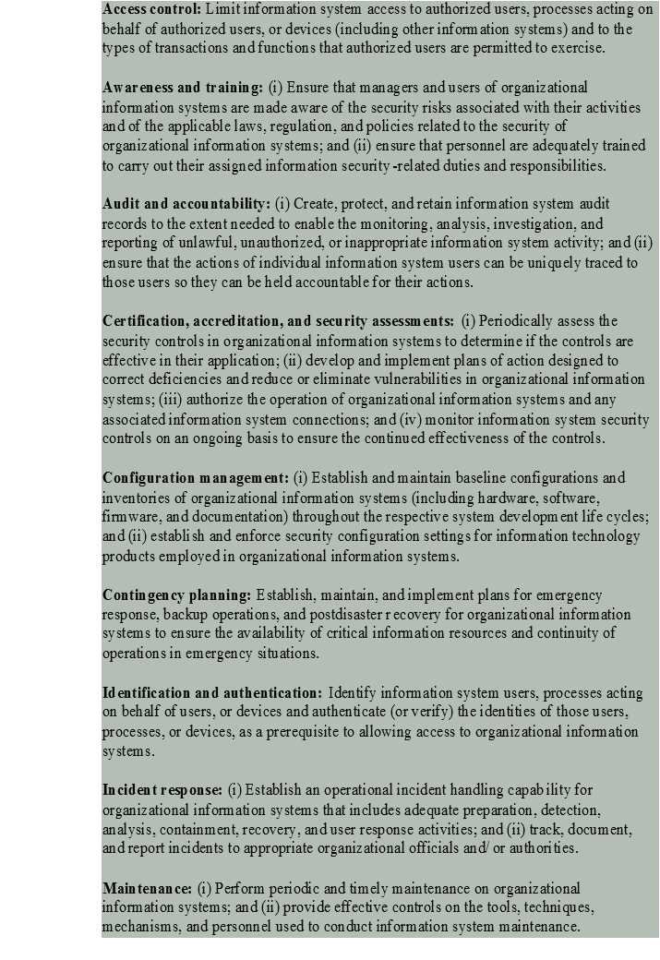
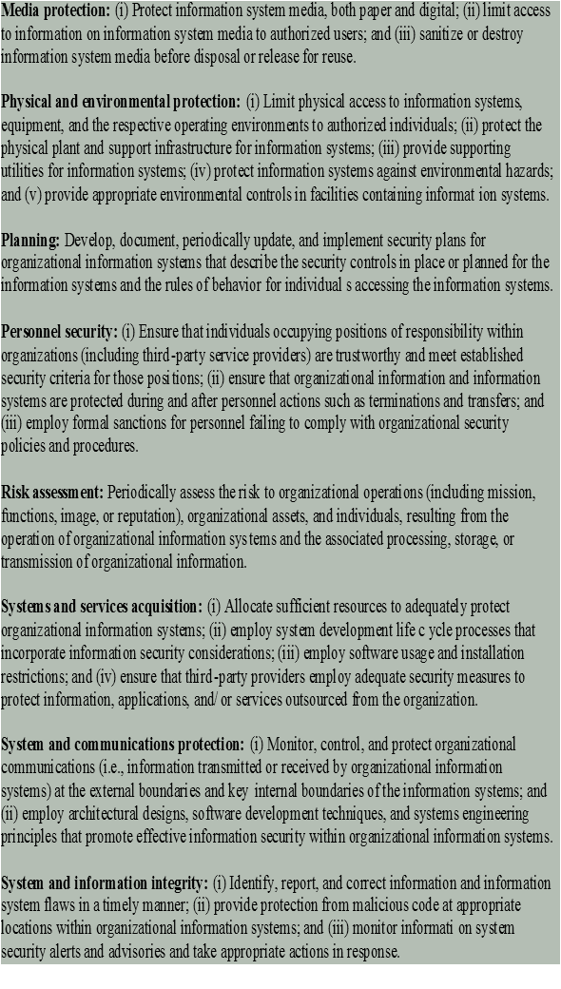



From Stallings & Brown textbook
Notes:
There are a number of ways of classifying and characterizing the countermeasures
that may be used to reduce vulnerabilities and deal with threats to system assets. It
will be useful for the presentation in the remainder of the book to look at several
approaches, which we do in this and the next two sections. In this section, we view
countermeasures in terms of functional requirements, and we follow the classification
defined in FIPS PUB 200 ( Minimum Security Requirements for Federal Information
and Information Systems ). This standard enumerates 17 security-related areas with
regard to protecting the confidentiality, integrity, and availability of information
systems and the information processed, stored, and transmitted by those systems.
The areas are defined in Table 1.4 .
The requirements listed in FIP PUB 200 encompass a wide range of countermeasures
to security vulnerabilities and threats. Roughly, we can divide these
countermeasures into two categories: those that require computer security technical
measures (covered in this book in Parts One and Two), either hardware or
software, or both; and those that are fundamentally management issues (covered in
Part Three).

Slide 20
OSI Security Architecture
The International Telecommunication Union (ITU) Recommendation X.800 defines the Security Architecture for Open System Interconnection (OSI) Architecture
  To asses the security needs of an organization
  To evaluate and choose various security products and policies
  To define security requirements and approaches to satisfy the requirements
OSI Security Architecture focuses on
  Security Attack. Any action that compromises the security information owned by an organization.
  Security Mechanism. A process to detect, prevent, or recover from a security attack.
  Security Service. A service that enhances the security of the data processing systems and the information transfers of an organization to counter security attacks by making use of one or more security mechanisms

Slide 21
OSI Security Services
X 800 divides security services into six categories and 14 specific services.
X800 focuses on distributed and networked systems
  It stresses on network security than single computer security
Six categories of security services:
Authentication. Make sure that a communication is authentic
Access control. Limit and control accesses to host systems through communication channels
Data confidentiality. Protect data from passive attacks
Data Integrity. Make sure that data received is that sent by authorized entity
Nonrepudiation. Prevent sender or receiver from denying a transmitted data.
Availability. Prevent denial of authorized access to system resources

Slide 22
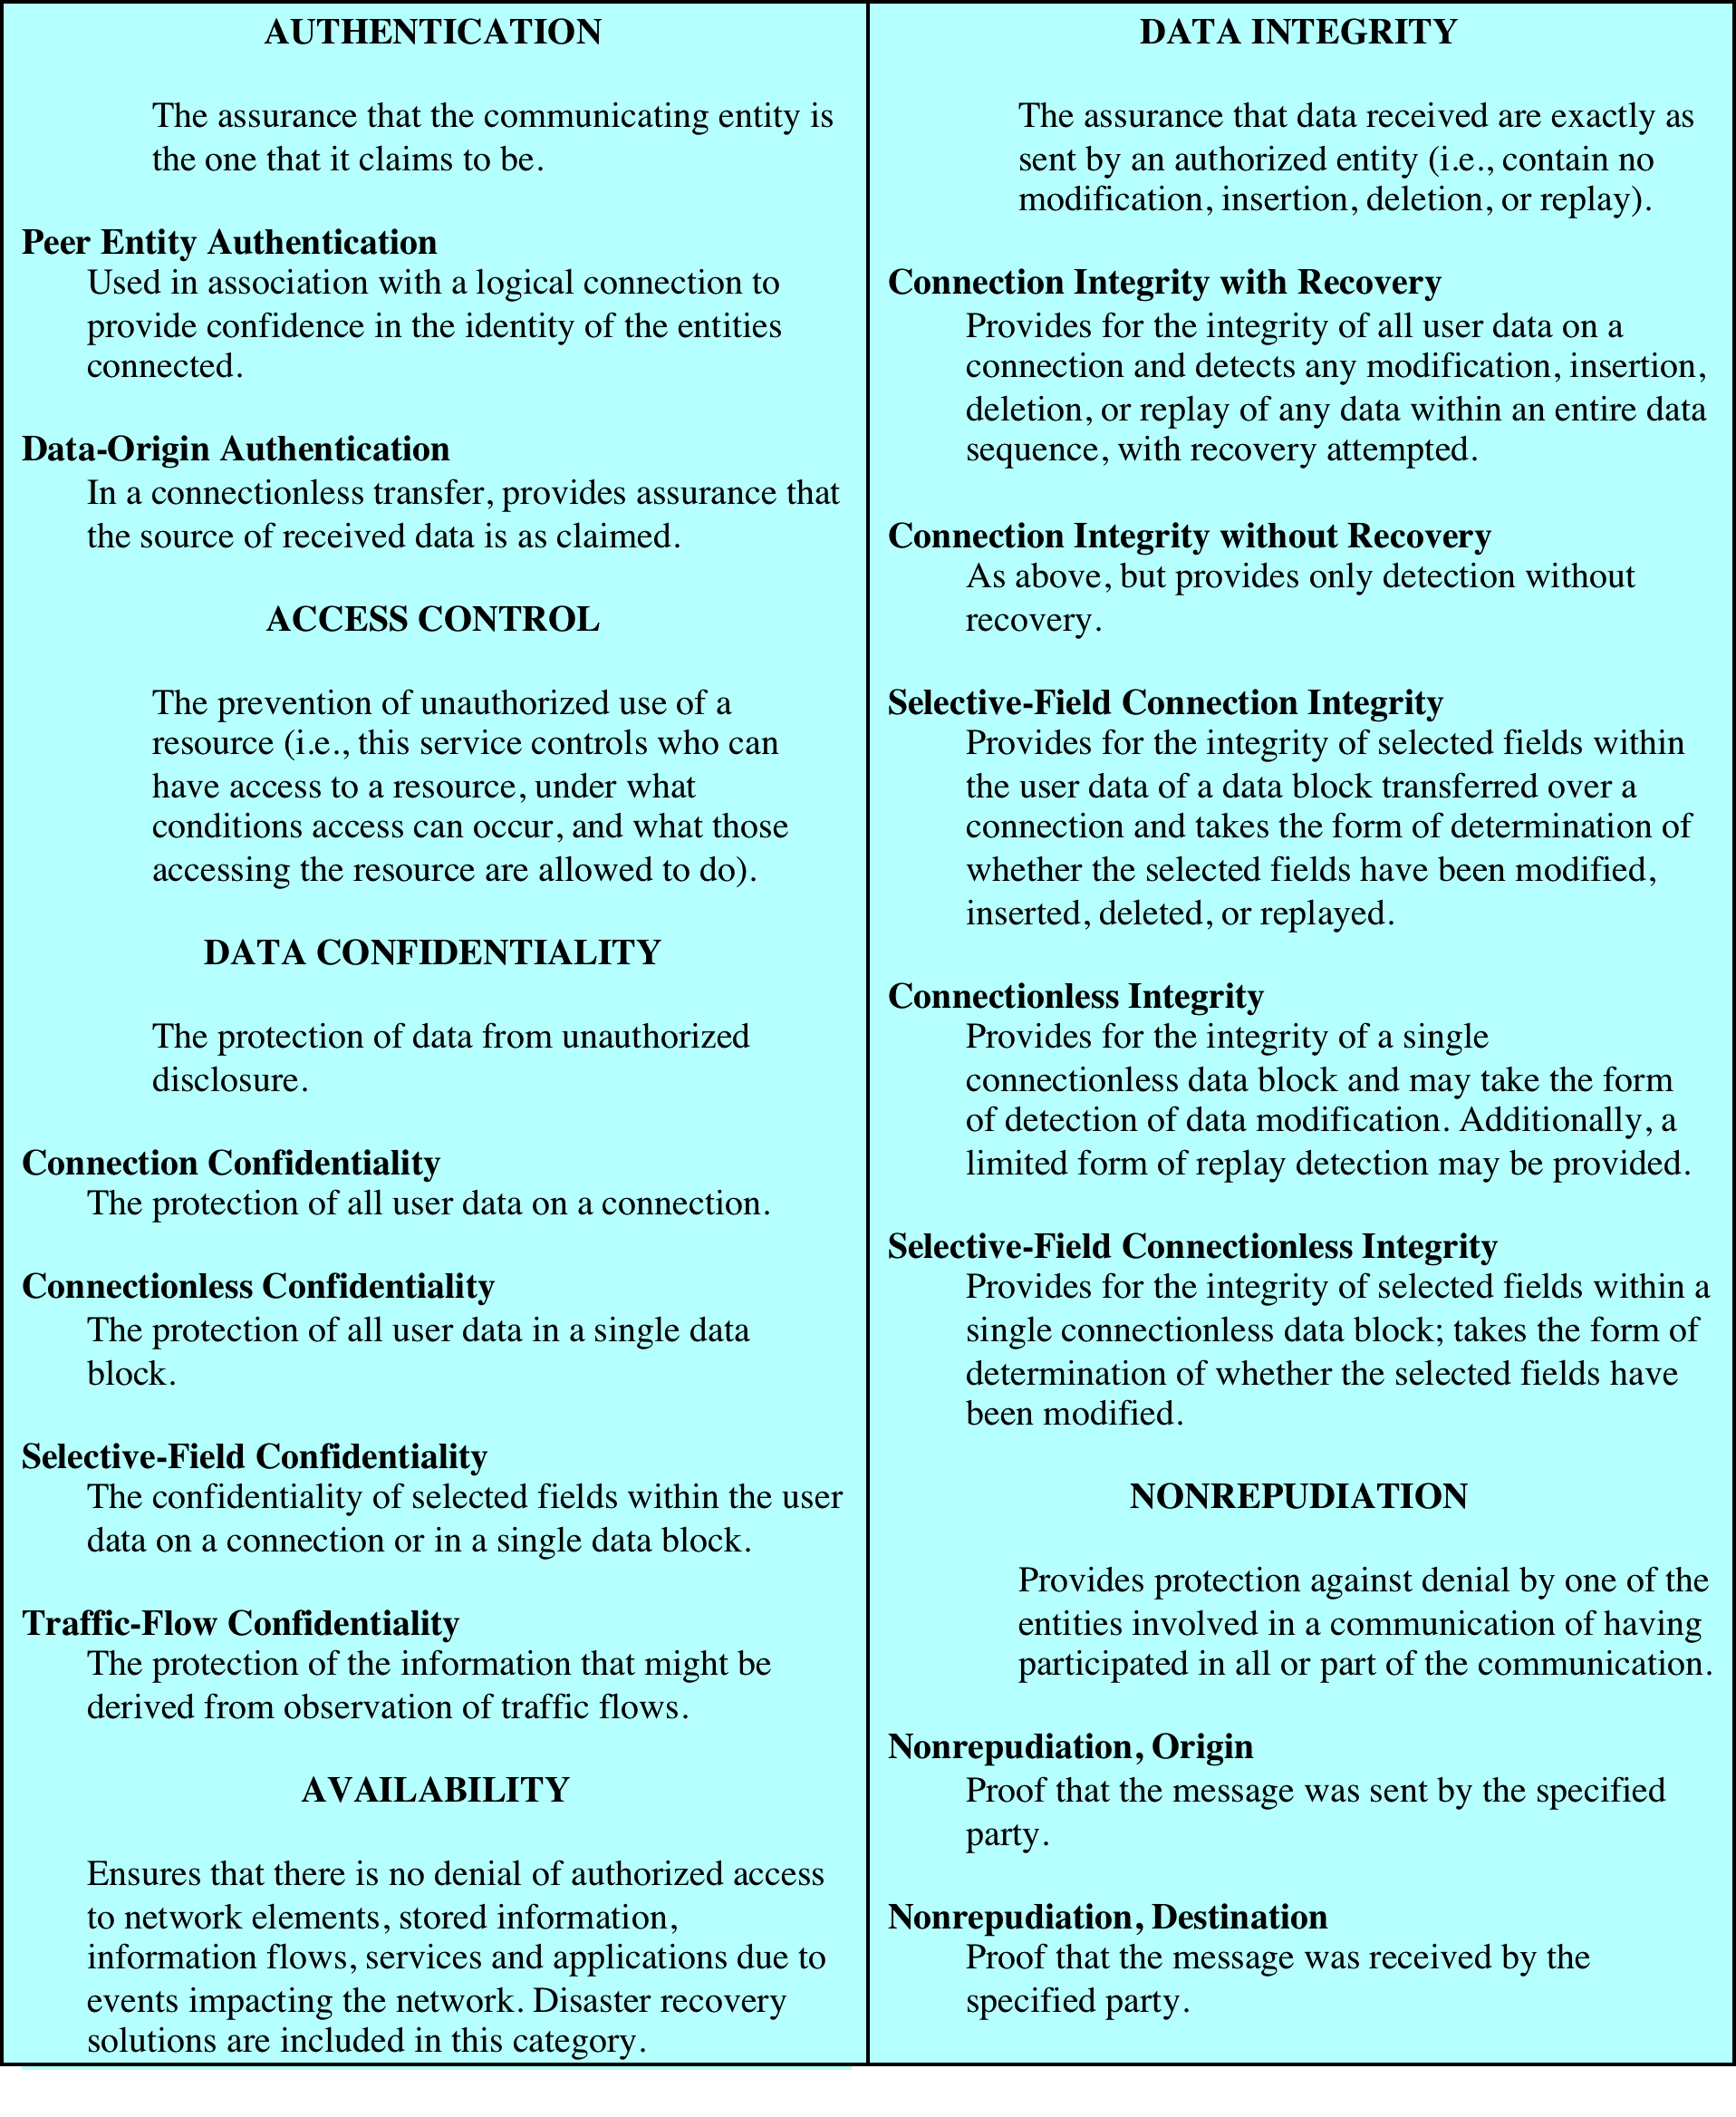
Table 1.5
Security
Services
Figure from Stallings & Brown textbook
Source: From X.800, Security Architecture for OSI

Slide 23
OSI Security Mechanism
X800 divides security mechanism into
Those specific to specific protocol layers and protocol applications, e.g., TCP
Others.

Slide 24
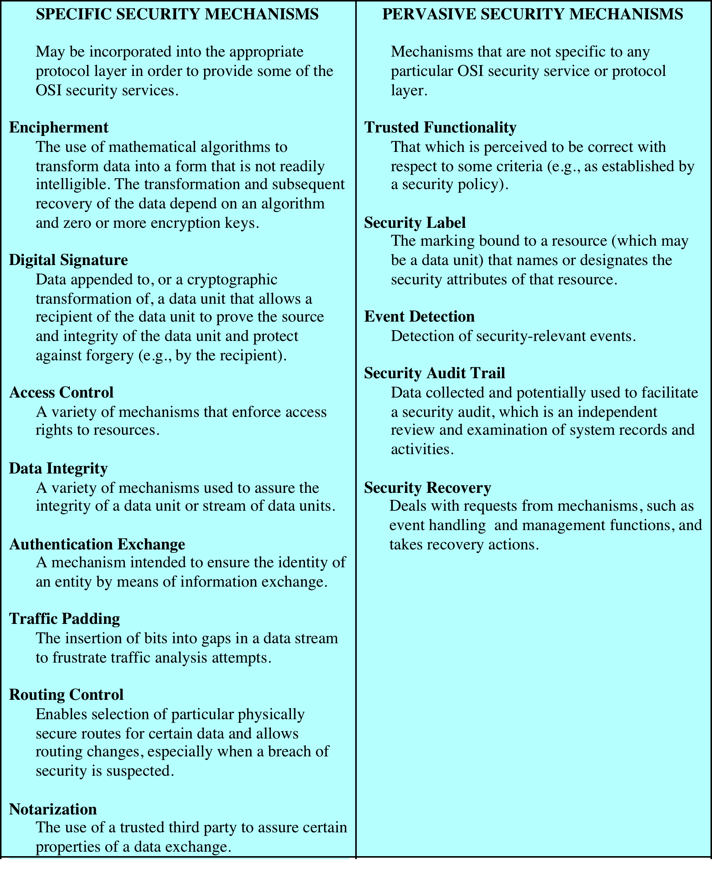
TABLE 1.6
X.800
Security
Mechanisms
Figure from Stallings & Brown textbook
CRICOS Code 0301J Distributed Computing Security Issues 500

Slide 25
Computer Security Trends
Survey (2010/2011) conducted by Computer Security Institute with respondents from 350 organizations in US based on
Types of Attacks (see Fig. 1.4)
  There is growing incidents on malware infection
Security Technology used (See Fig. 1.5)
  Most organizations use anti-virus software and firewalls

Slide 26
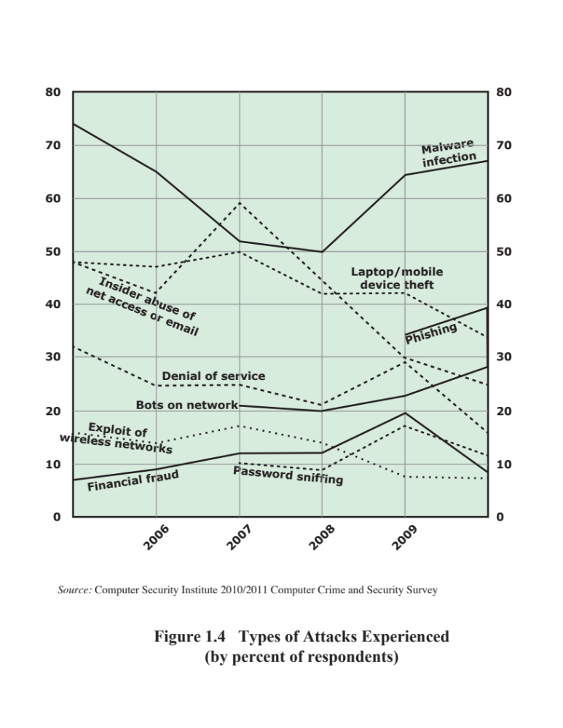
Figure 1.4
Security Trends
Figure from Stallings & Brown textbook
Notes:
In order to assess the relative severity of various threats and the relative importance
of various approaches to computer security, it is useful to look at the experience of
organizations. A useful view is provided by the CSI Computer Crime and Security
Survey for 2010/2011, conducted by the Computer Security Institute. The respondents
consisted of over 350 U.S.-based companies, nonprofit organizations, and
public sector organizations.
Figure 1.4 shows the types of attacks experienced by respondents in nine
major categories. 6 Most noteworthy is the large and growing prevalence of malicious
software (malware) attacks. It is also worth noting that most categories of
attack exhibit a somewhat downward trend. The CSI report speculates that this is
due in large part to improved security techniques by organizations.

Slide 27
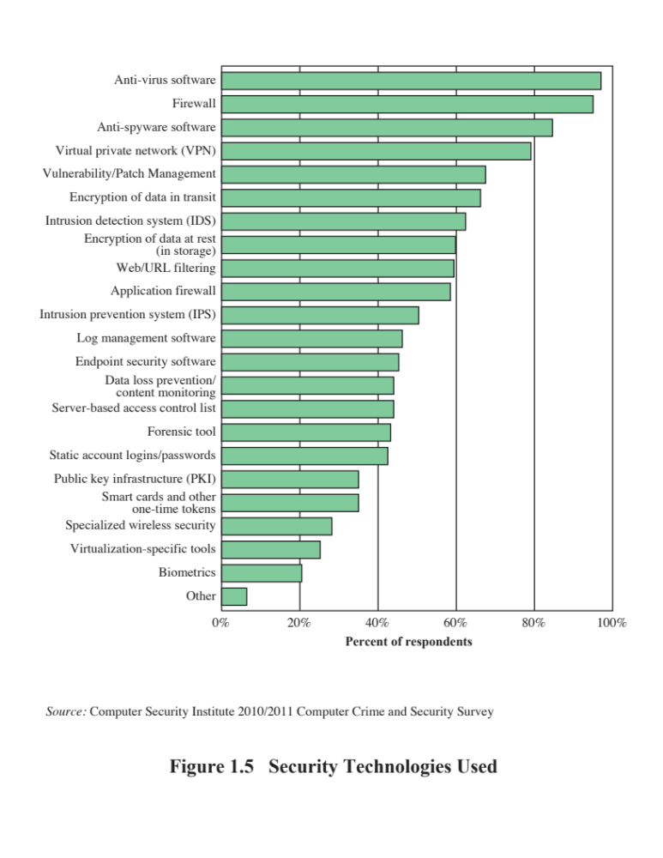
Figure from Stallings & Brown textbook

Slide 28
Computer Security Strategy
Lampson suggests a security strategy to include three aspects
Specification/policy: What to do
Implementation/mechanisms: How to do it
Correctness/assurance: Does it work
Factors to considers for Security Policy:
The value of the assets to be protected
The system’s vulnerabilities
Potential threats and their possible attacks
Ease of use versus security
Cost of security versus cost of security failure and recovery

Slide 29
Computer Security Strategy (cont. )
Security implementation includes these four complementary actions:
Prevention
  This is an ideal case; but not always feasible
Detection
  When prevention is not possible, detect security attacks
  Can use intrusion detection
Response
  When an attack is detected, respond to halt the attack or prevent further damage
Recovery
  Recover from the attack by using, for example, a backup copy

Slide 30
Computer Security Strategy (cont. )
NIST defines assurance as:
The degree of confidence one has that the security measures, both technical and operational, work as intended to protect the system and the information it processes
Does the security system design meet its requirements?
Does the security system implementations meet its specifications?
Evaluation is the process of examining a computer product or system with respect to certain criteria
Involves testing and analysis

